Slide 1

HPV Vaccine Initiative
Leslie Campbell, RN & Kayla Mathis, RN

Slide 2
Baseline Data Measurement
12/08/2017
KSWebIZ
19.4%
Collection
Date
Data Extracted
From
Compliance Rate

Slide 3
Goal
By December 2018, increase the Riley County Health Department’s HPV vaccine rates to 24.4% compliance (5% increase) for adolescents 11-18 years of age.

Slide 4
Strategic Planning & Action
Stonecreek Family Physicians - Dr. Rosso - United Community Approach
2/21/2018
A Presentation on Evidence Based Practices to all RCHD Nurses (RNs & APRN)
3/22/2018
PowToon Presentation - A Call to Action - All RCHD Staff (MCH, FP, WIC, etc.)
3/29/2018
Today
USD 383 - Provided Tools & Resources for School Nurses
4/2/2018
WebIZ Data Clean-up & Reminder/Recall Notifications - Increased Production with Nursing Students
FP - Implemented PowToon Call-to-Action - Screen & Schedule for Immunization Needs @ Each Visit
MCH & WIC - Implemented PowToon Call-To-Action Script
1/2/2018
4/12/2018
7/1/2018
Jan
Feb
Mar
Apr
May
Jun
Jul

Slide 5

PowToon Call-to-Action

Slide 6
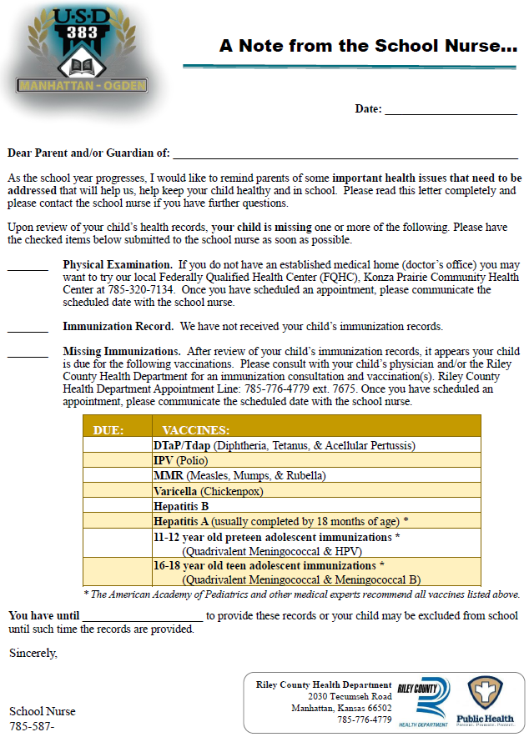
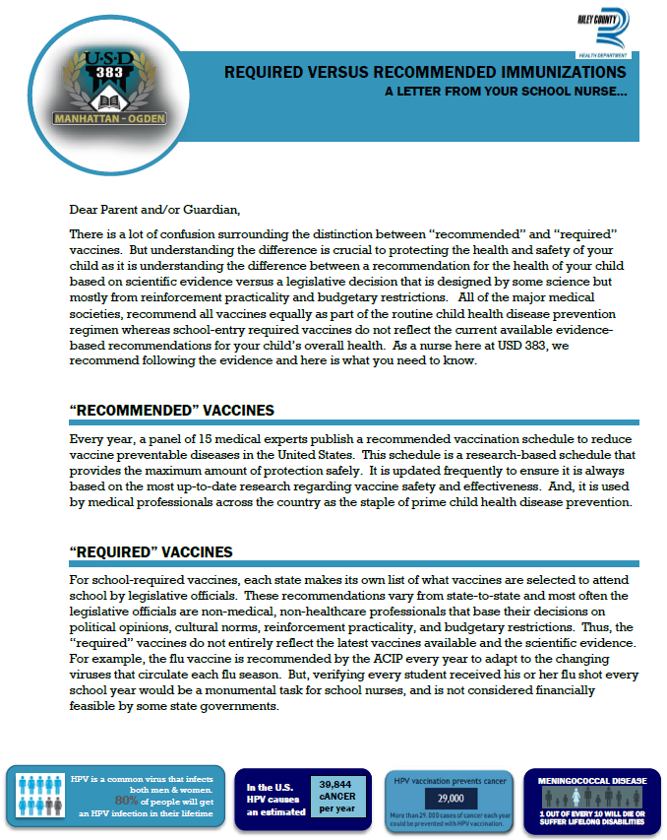
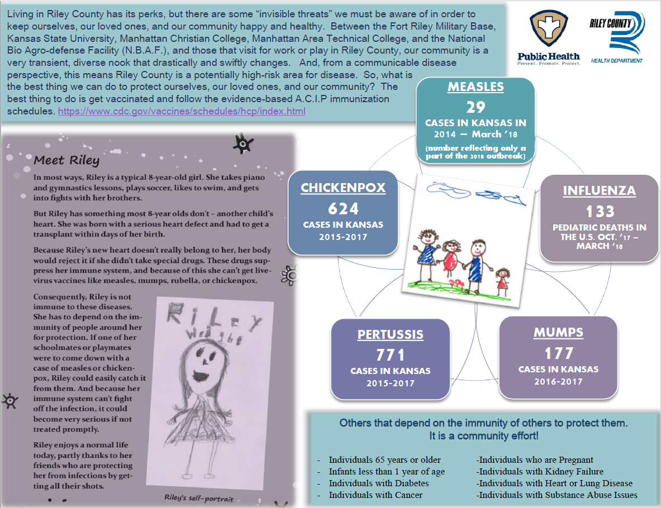
USD 383 Tools & Resources

Slide 7
Year End Data Measurement
11/05/2018
KSWebIZ
20.9%
Collection
Date
Data Extracted
From
Compliance Rate

Slide 8
Contact Us
Riley County Health Department
Leslie Campbell, RN
Clinic Supervisor
785-776-4779 ext. 7655
lcampbell@rileycountyks.gov

